Slide 1

Predicting the Traffic-Jam: Congestion-Aware Routing
Proposed by:
Niharika Shrivastava (IIIT, Allahabad)
Malika Meghjani (SUTD, Singapore)
Presented by:
Niharika Shrivastava

Slide 2

Talk Outline
Problem of congestion
Introduction to Multi-Class fleets
Architecture Overview
Python GIS Libraries
Implementation
Real case comparisons

Slide 3
Background
Everyone prefers shortest distance route
No. of vehicles exponentially increasing
Capacity of roads ⟶ CONSTANT!
Increasing travel times
Under-utilization of a city’s road network.
Fig. 1: Gridlock on road intersections due to unintelligent routing

Slide 4
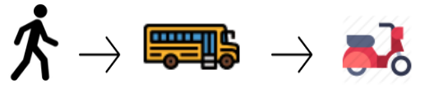
Use multi-class fleets instead?
Break a customer trip into 3 classes:
First mile:
Last mile:
Middle mile: Covers ~90% of the trips using fast-speed cars or public transports.
Use cycles, scooters, walking on pedestrian paths
Fig. 2: Customer trip performed using a multi-class fleet of vehicles

Slide 5
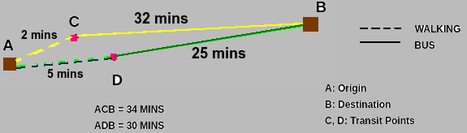
What are we doing?
Route customer trips in a congestion-aware manner using a multi-class fleet of vehicles.
Provides optimal transit points for each trip.
Create a social model.
Wardrop User Equilibrium
Wardrop System Equilibrium
✅
Fig. 3: A multi-class setup (walking + bus). D is the optimal transit point for minimum trip time

Slide 6
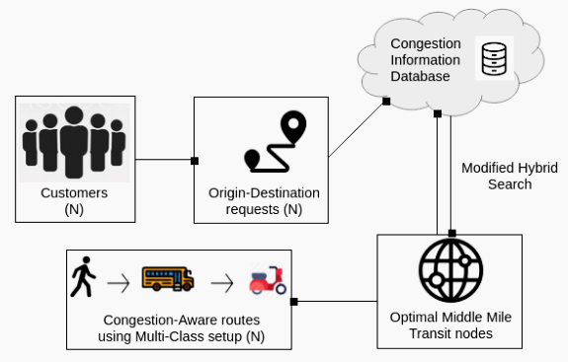
Architecture
Frank-Wolfe Optimizer
Fig. 4: Workflow

Slide 7
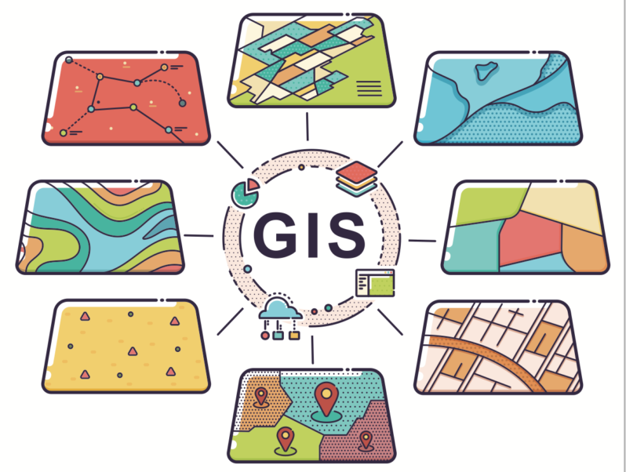
Geographic Information System [GIS]
It’s a computer system for capturing, storing, checking, and displaying data related to positions on Earth’s surface.

Slide 8
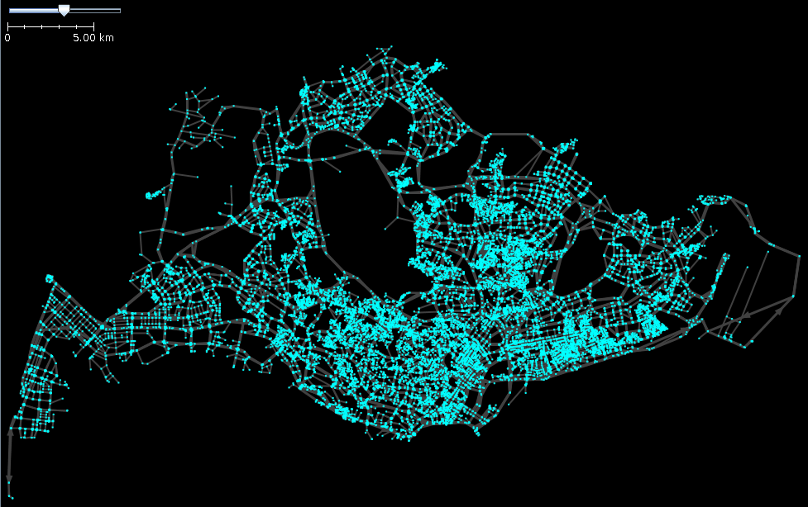
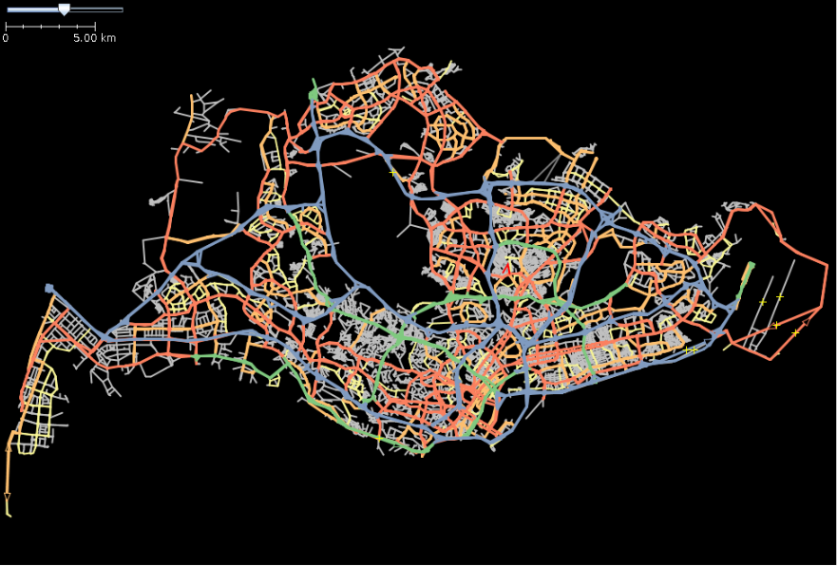
Python GIS Libraries
OSMNx:
Retrieve, model, analyze, and visualize OpenStreetMap street networks and other spatial data.
Fig. 5: Nodes (V)
Fig. 6: Edges (E)

Slide 9
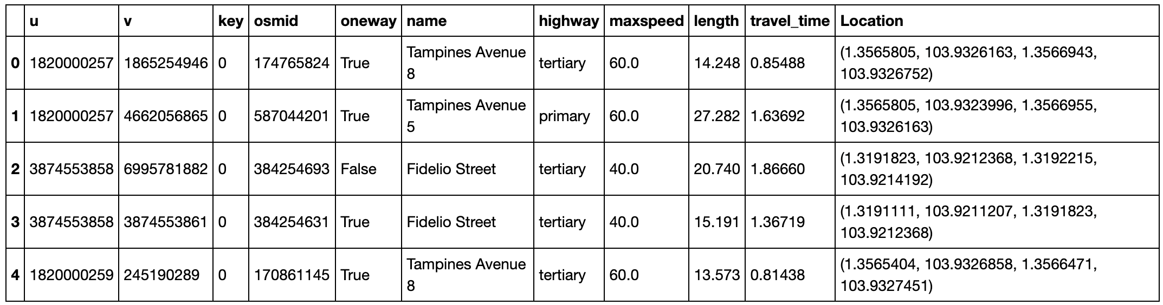
Python GIS Libraries
GeoPandas:
Extends the datatypes used by pandas to allow spatial operations on geometric types.
Fig. 7: Singapore’s Edge Dataframe

Slide 10
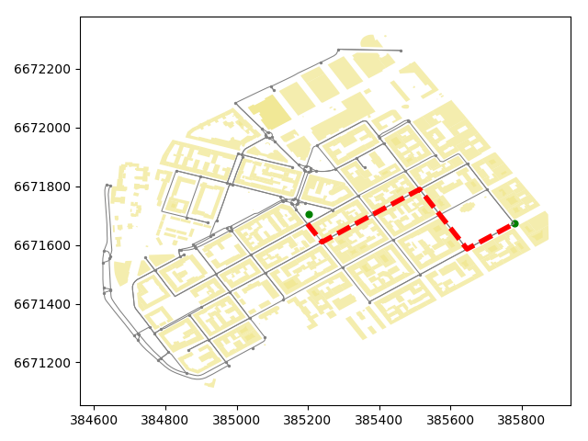
Python GIS Libraries
NetworkX:
Create, manipulate, and study the structure, dynamics, and functions of complex networks.

Slide 11
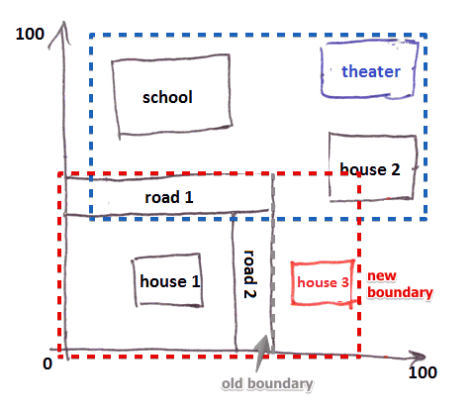
Python GIS Libraries
Rtree:
Provides advanced spatial indexing features like nearest neighbor search, intersection search

Slide 12
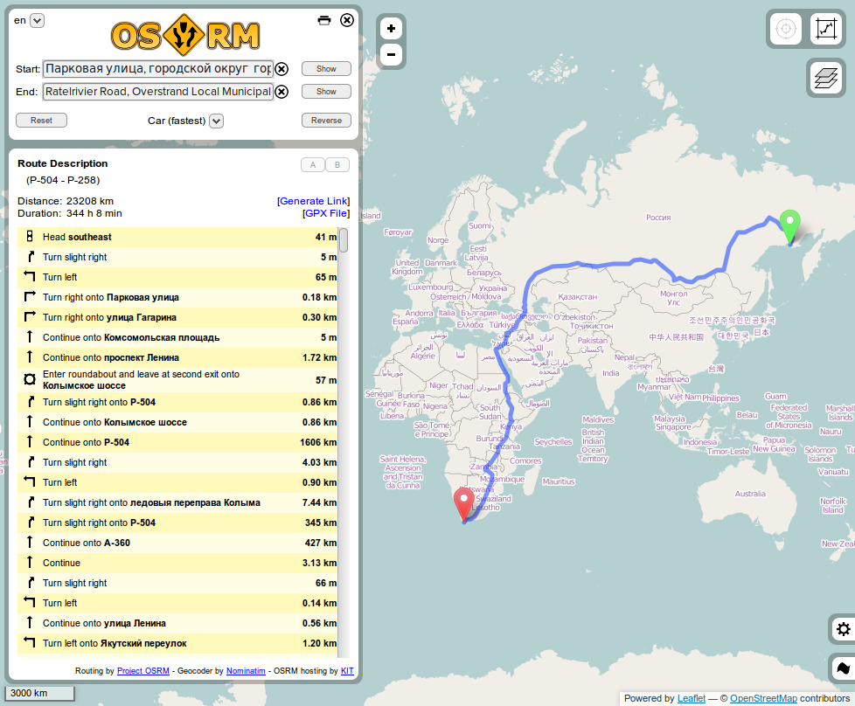
Project OSRM
Contraction Hierarchies:
For an 80-mile route search query,
Dijkstra's algorithm → 500,000 nodes
A* search → 50,000 nodes
Contraction Hierarchies → 600 nodes.

Slide 13
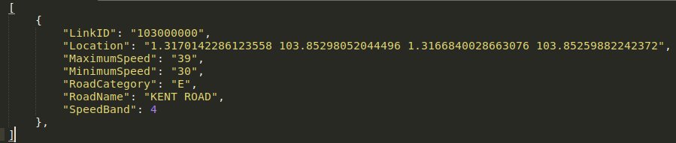
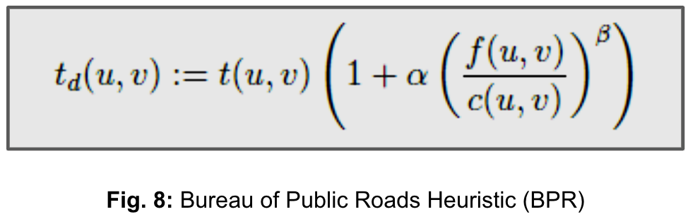
Implementation: Compute congestion!
Fig. 7: Singapore’s Traffic Speed Band Dataset

Slide 14



Implementation: Divide into 3 miles
WALKING
Fig. 9: How assignment is done
BUS
Bus Stop D
Bus Stop C
Bus Stop B
Bus Stop E
500M radius
500M radius
Bus Stop F
Bus Stop A
SOURCE
DESTINATION

Slide 15
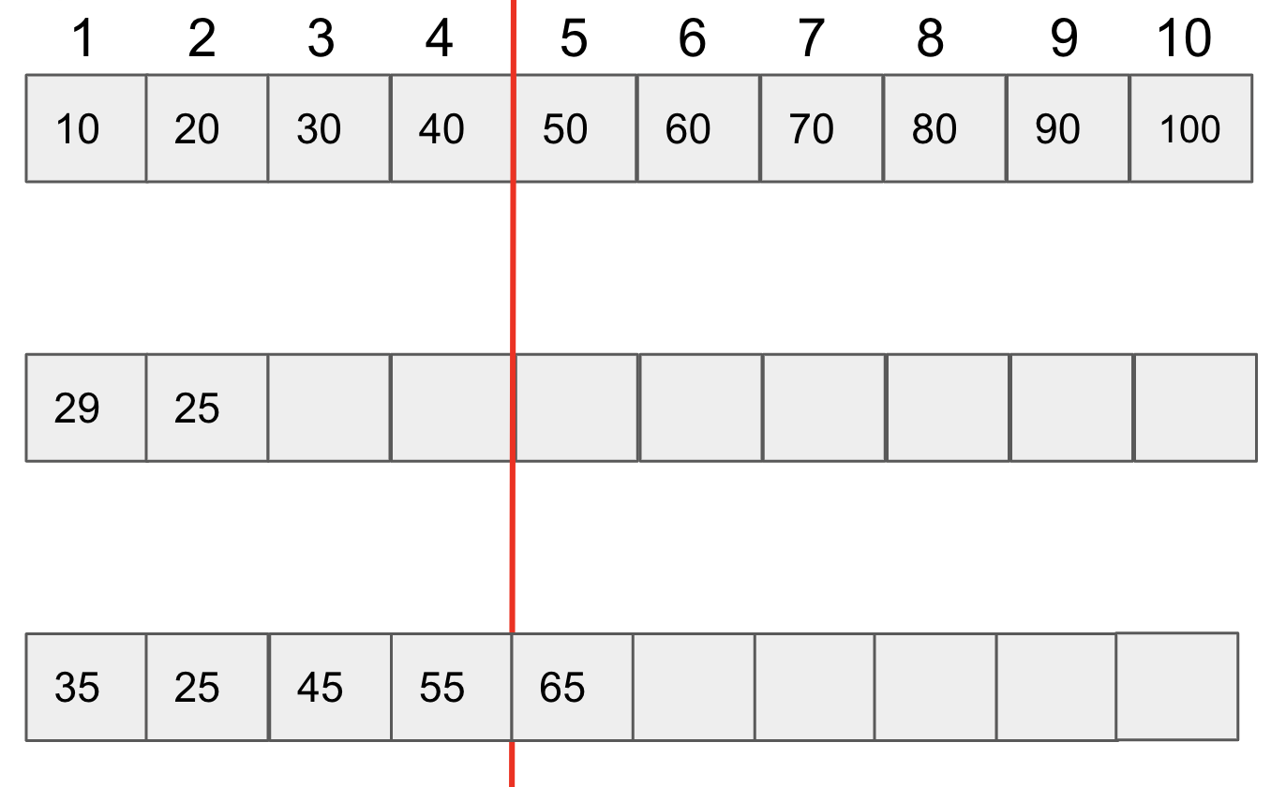
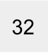
Modified Hybrid Search: Transit point selection
AIM: Find minimum travel-time
Let N = 10 [No. of possible routes]
Cutoff = Ceil(N/e) = 4 [index]
Decider = Cutoff + 1 = 5 [index]
Case 1: Actual time < next Euclidean time
No. of queries = 2 = 80% reduction
Case 2: Min pair < or > Decider
No. of queries = 5 = 50% Reduction
Pairs:
(a1,b1)
(a2,b2)
(a3,b3)
(a4,b4)
(a5,b5)
(a6,b6)
(a7,b7)
(a8,b8)
(a9,b9)
(a10,b10)
Sorted Euclidean travel-time:
Case 1:
Case 2:
or
60
55
63
65
52

Slide 16
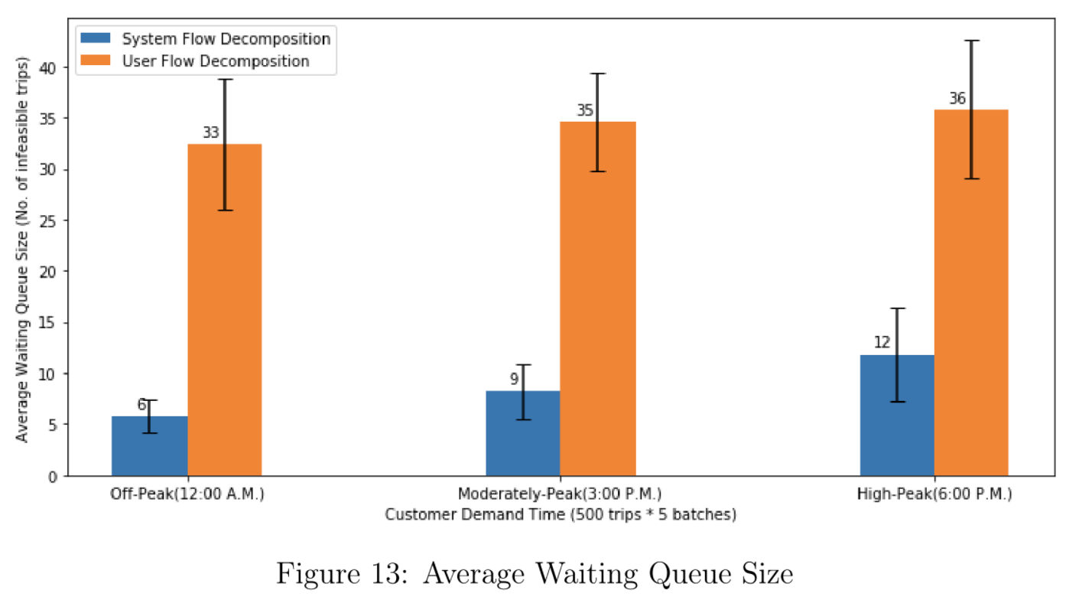
Multi-Class System Framework V.S.
Single-Class User Framework
Network Utilization:
0% congestion rate at all times
% Avg. network utilization increase = 74.26%

Slide 17
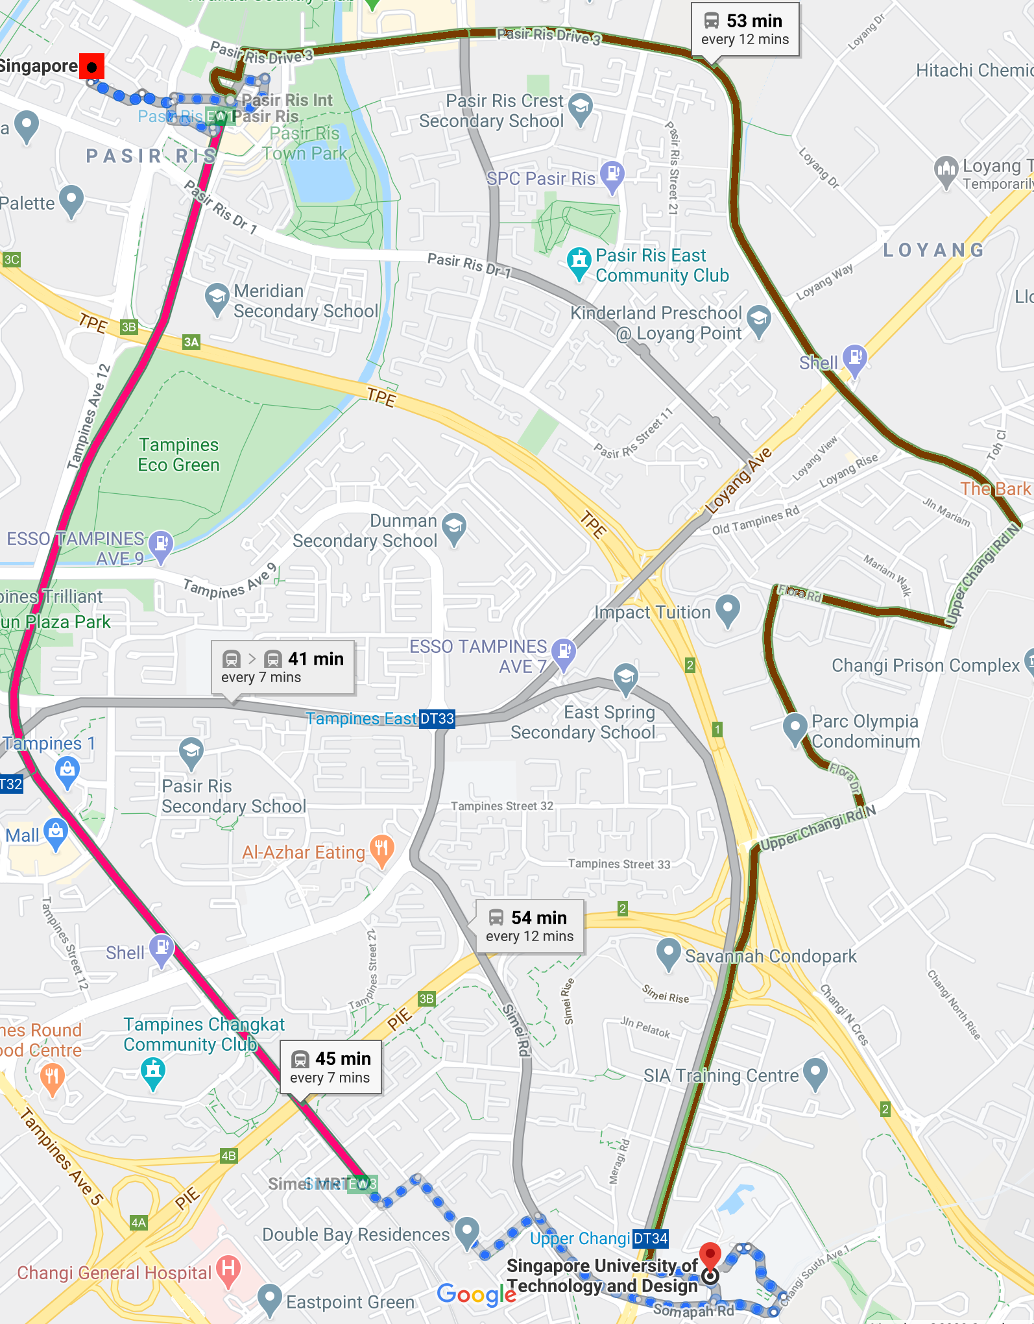
Multi-Class
VS
Google Maps
Solid brown lines: Path recommended by Google Maps ⓒ
First + Last mile = 21 mins of walking
Total trip time = 53 mins.
Solid red lines: Path recommended by our congestion-aware multi-class framework
First + Last mile = 33 mins of walking
Total trip time = 45 mins.
By increasing the usage of pedestrian networks slightly, overall trip times can be reduced.

Slide 18
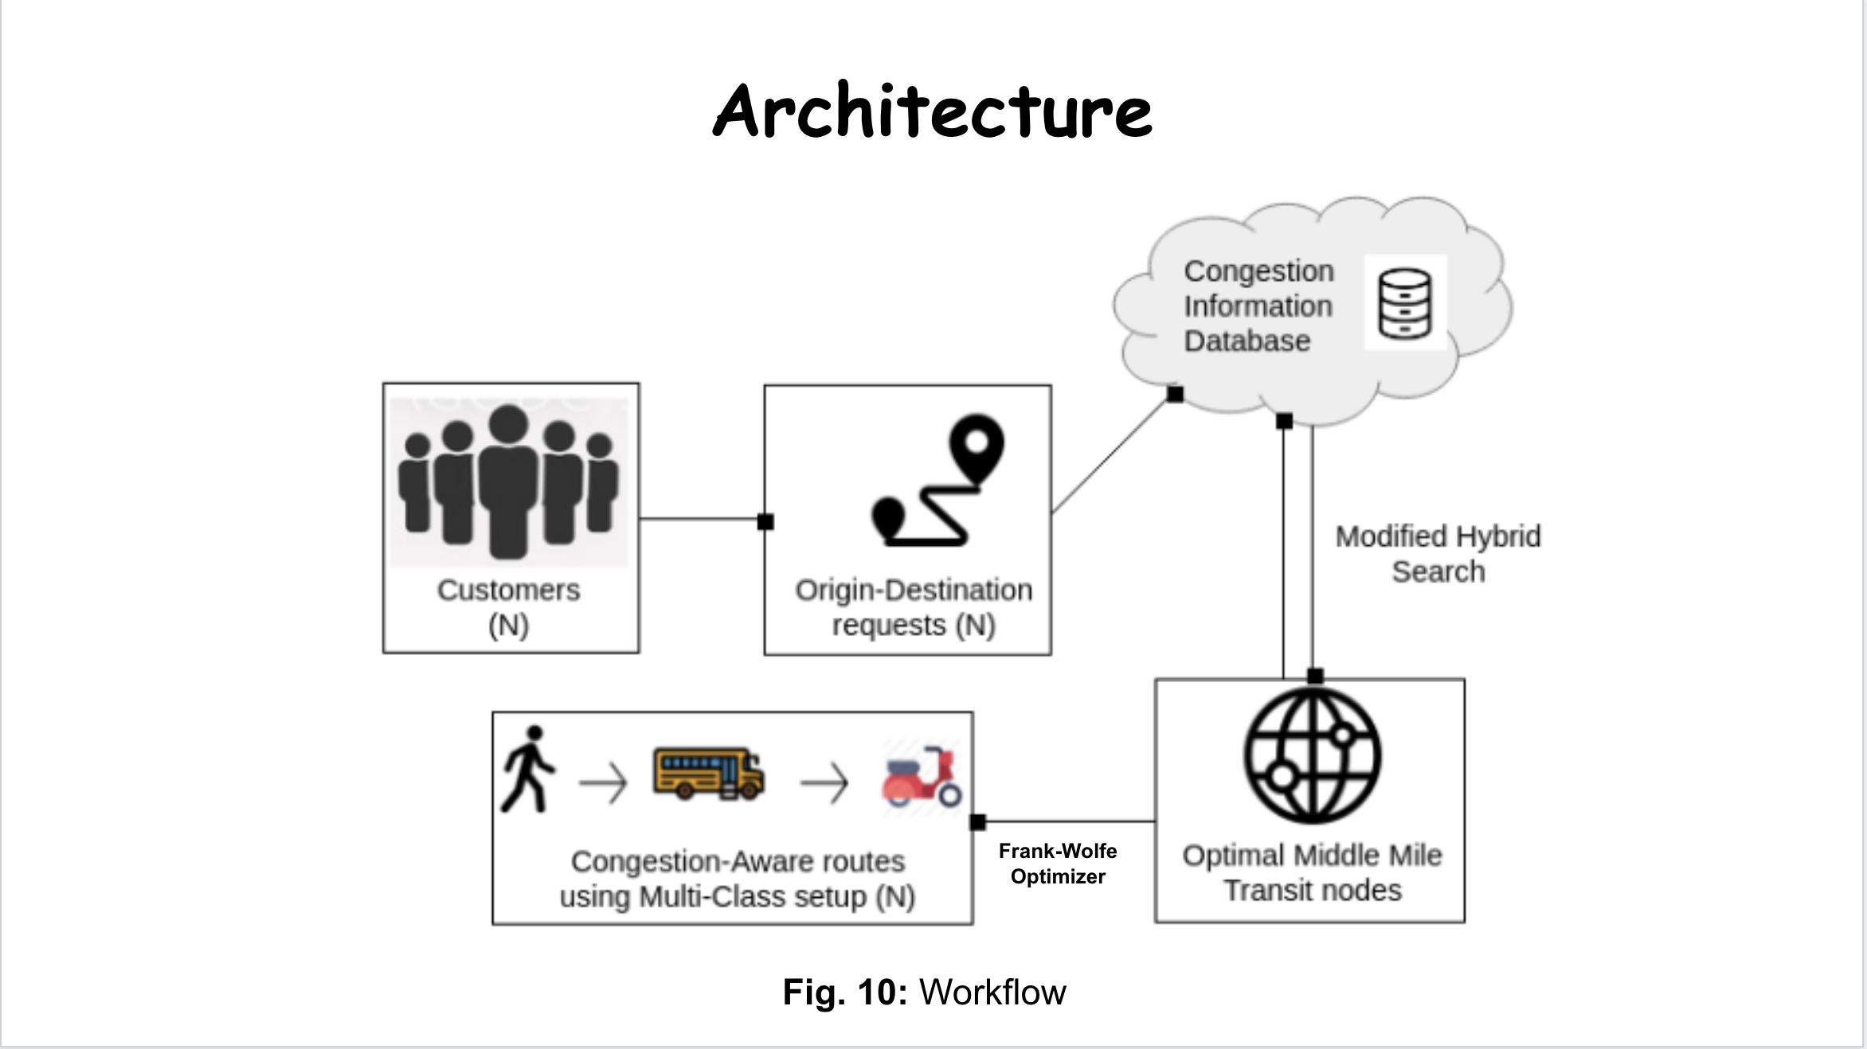
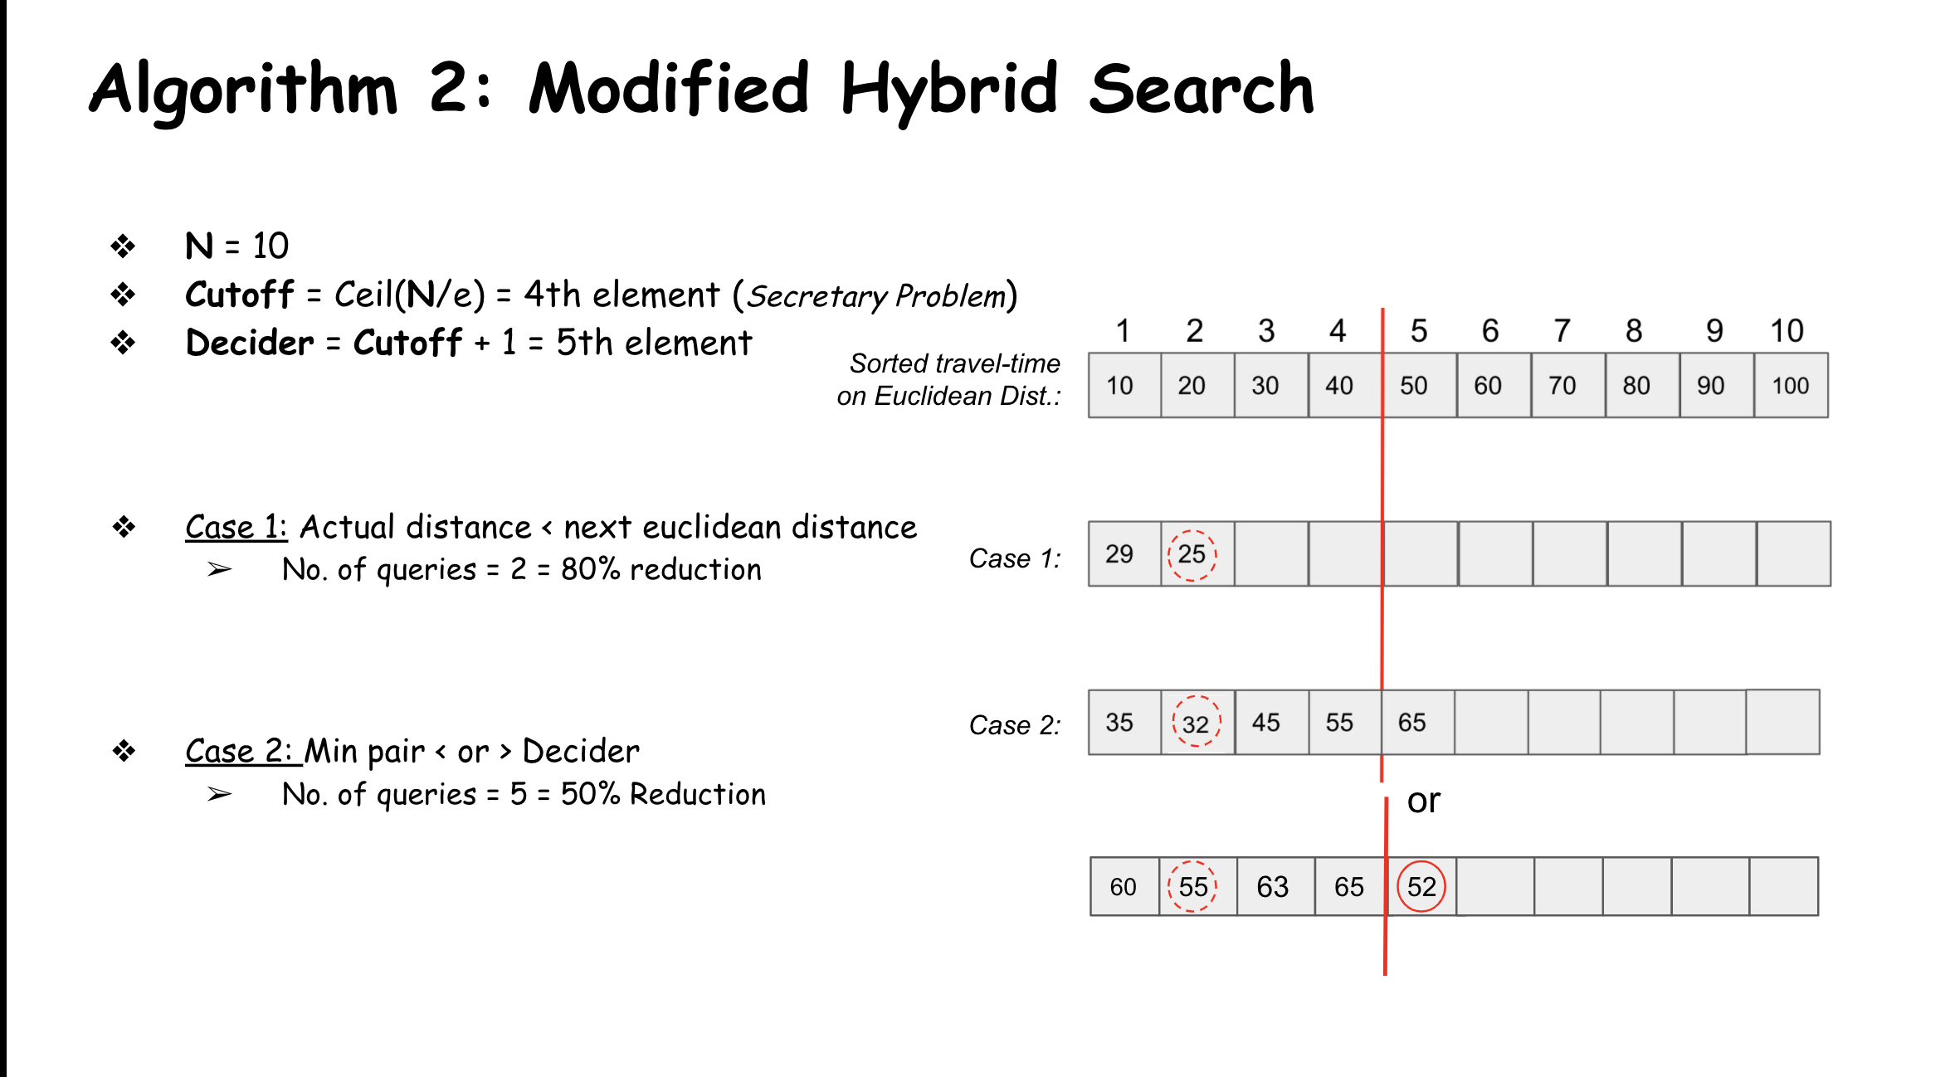
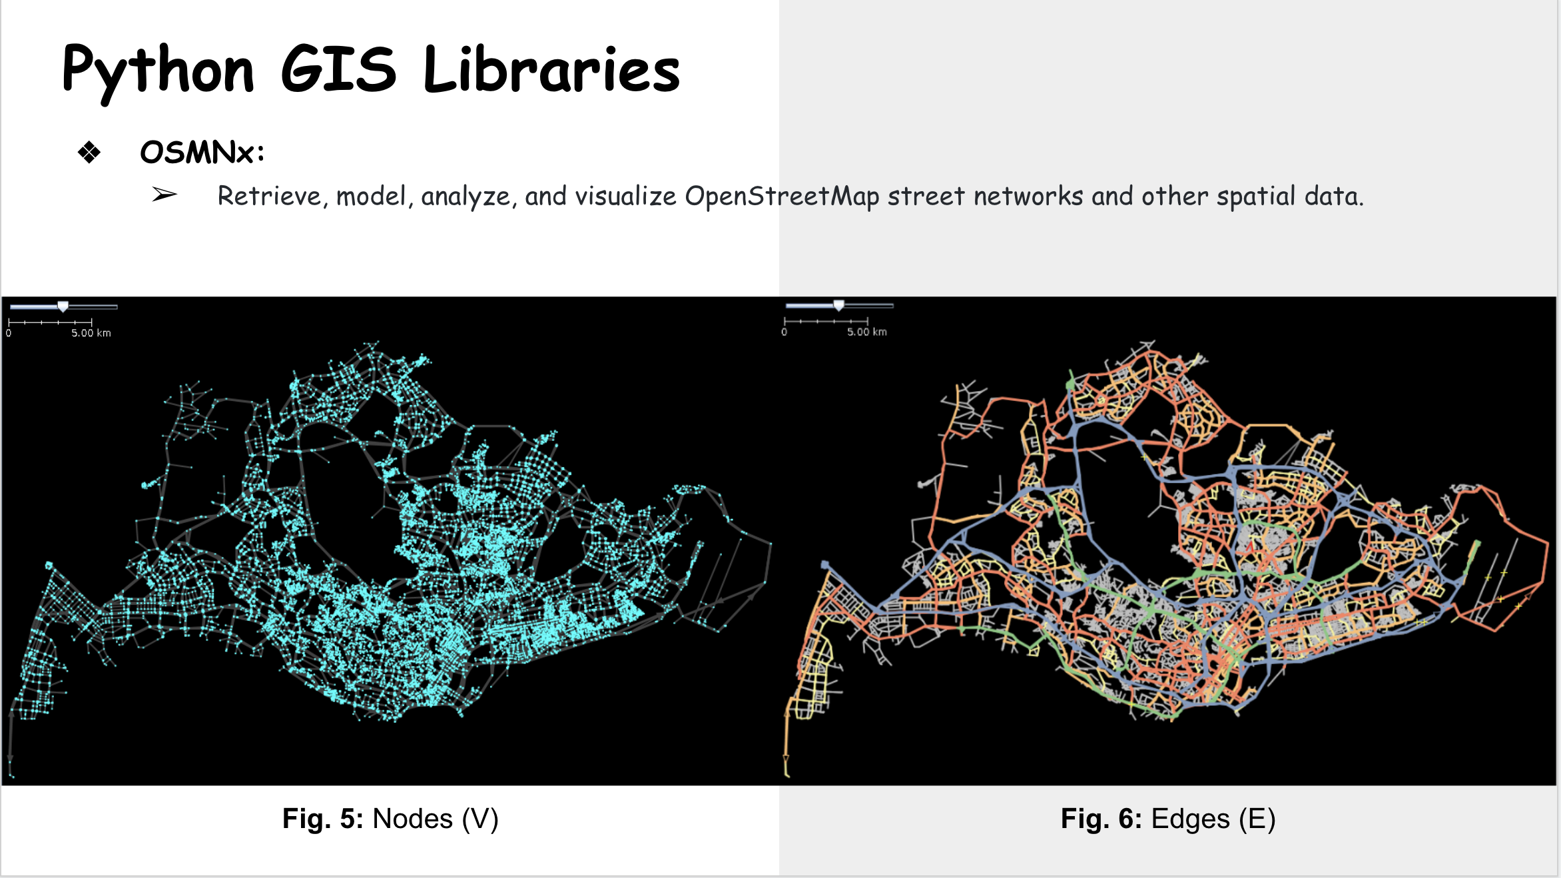
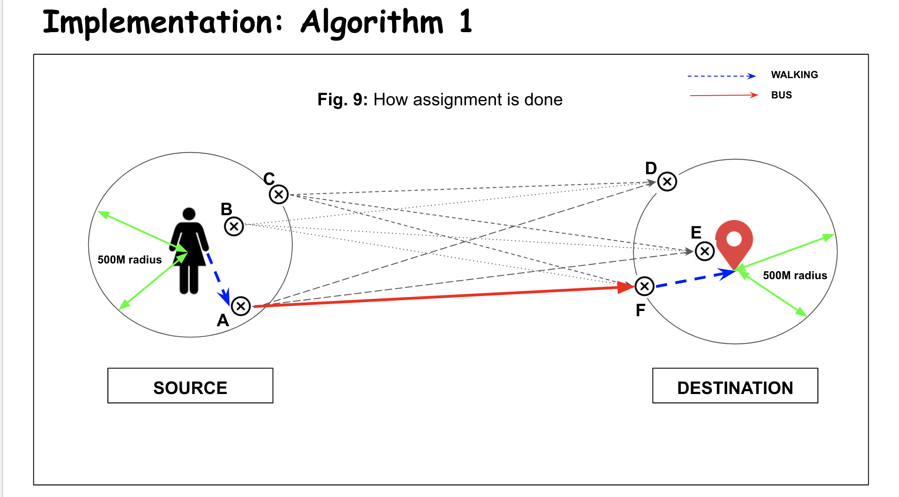
Summarizing in case you slept! ;)

Slide 19

Aaaand THANK YOU!

